Slide 1
PROJECT PRESENTATION
MULTI-PDF QA
CHATBOT USING
LLM & RAG
An intelligent document question-answering system for interacting with multiple PDFs in natural language.
Presented by Sakshi Kumari
Computer Science & Engineering – Data Science, Section F

Slide 2



Time-consuming
Extracting information across multiple PDFs is time-consuming.
THE PROBLEM
MANUAL PDF
SEARCH BREAKS
DOWN AT SCALE
Keyword limits
Keyword search often misses meaning behind a question.
Too much context
Large documents contain more context than can be passed directly to an LLM.
Retrieval changes the equation.
The solution retrieves only the most relevant passages, then generates a concise answer.
02

Slide 3
FROM FILES TO ANSWERS
The system turns multiple PDFs into one searchable knowledge base
01
02
03
04
05
Upload
Extract
Embed
Retrieve
Generate
Process multiple PDF documents.
Split text into manageable chunks.
Convert chunks into semantic vector embeddings.
Find relevant context for each user query.
Produce a context-aware answer through an LLM.
03

Slide 4
SYSTEM ARCHITECTURE
Interface
01
Streamlit with a custom HTML and CSS chat experience.
Processing
02
Python and PyPDF2 extract document text.
Orchestration
03
LangChain manages document processing and the RAG pipeline.
FIVE LAYERS
MAKE THE
CHATBOT WORK
Embeddings
04
Sentence Transformers encode meaning.
Search + inference
05
FAISS performs similarity retrieval; Hugging Face supplies LLM inference.
Each layer has one job. Together they form the product.
04

Slide 5

THE CORE LOOP
RAG connects retrieval to generation
Upload PDFs
Extract Text
Chunk Documents
Index & Search
RAG = Retrieval + Generation
The model answers from relevant document context instead of the full corpus.
05

Slide 6

WHY IT WORKS
Semantic retrieval is the core advantage
Extraction
Embedding
PyPDF2 extracts text and creates overlapping chunks.
all-MiniLM-L6-v2 converts each chunk into embeddings.
Retrieval
Generation
FAISS compares query embedding with stored chunk embeddings.
LLM receives retrieved context and produces a response.
The system compares meaning, not only matching words.
all-MiniLM-L6-v2 · FAISS · context-aware response
06

Slide 7
RELIABILITY LAYER
Fallback models improve reliability
PRIMARY OPTIONS
FALLBACK
Mistral 7B Instruct
BART
Phi-3 Mini · Zephyr 7B · LLaMA 2 Chat
Can serve as a summarization fallback.
SEQUENTIAL RETRY
WHY IT MATTERS
Try what is available.
Availability limits
The application attempts available models sequentially when loading or inference fails.
This approach helps address limits in free-tier inference services.
07

Slide 8
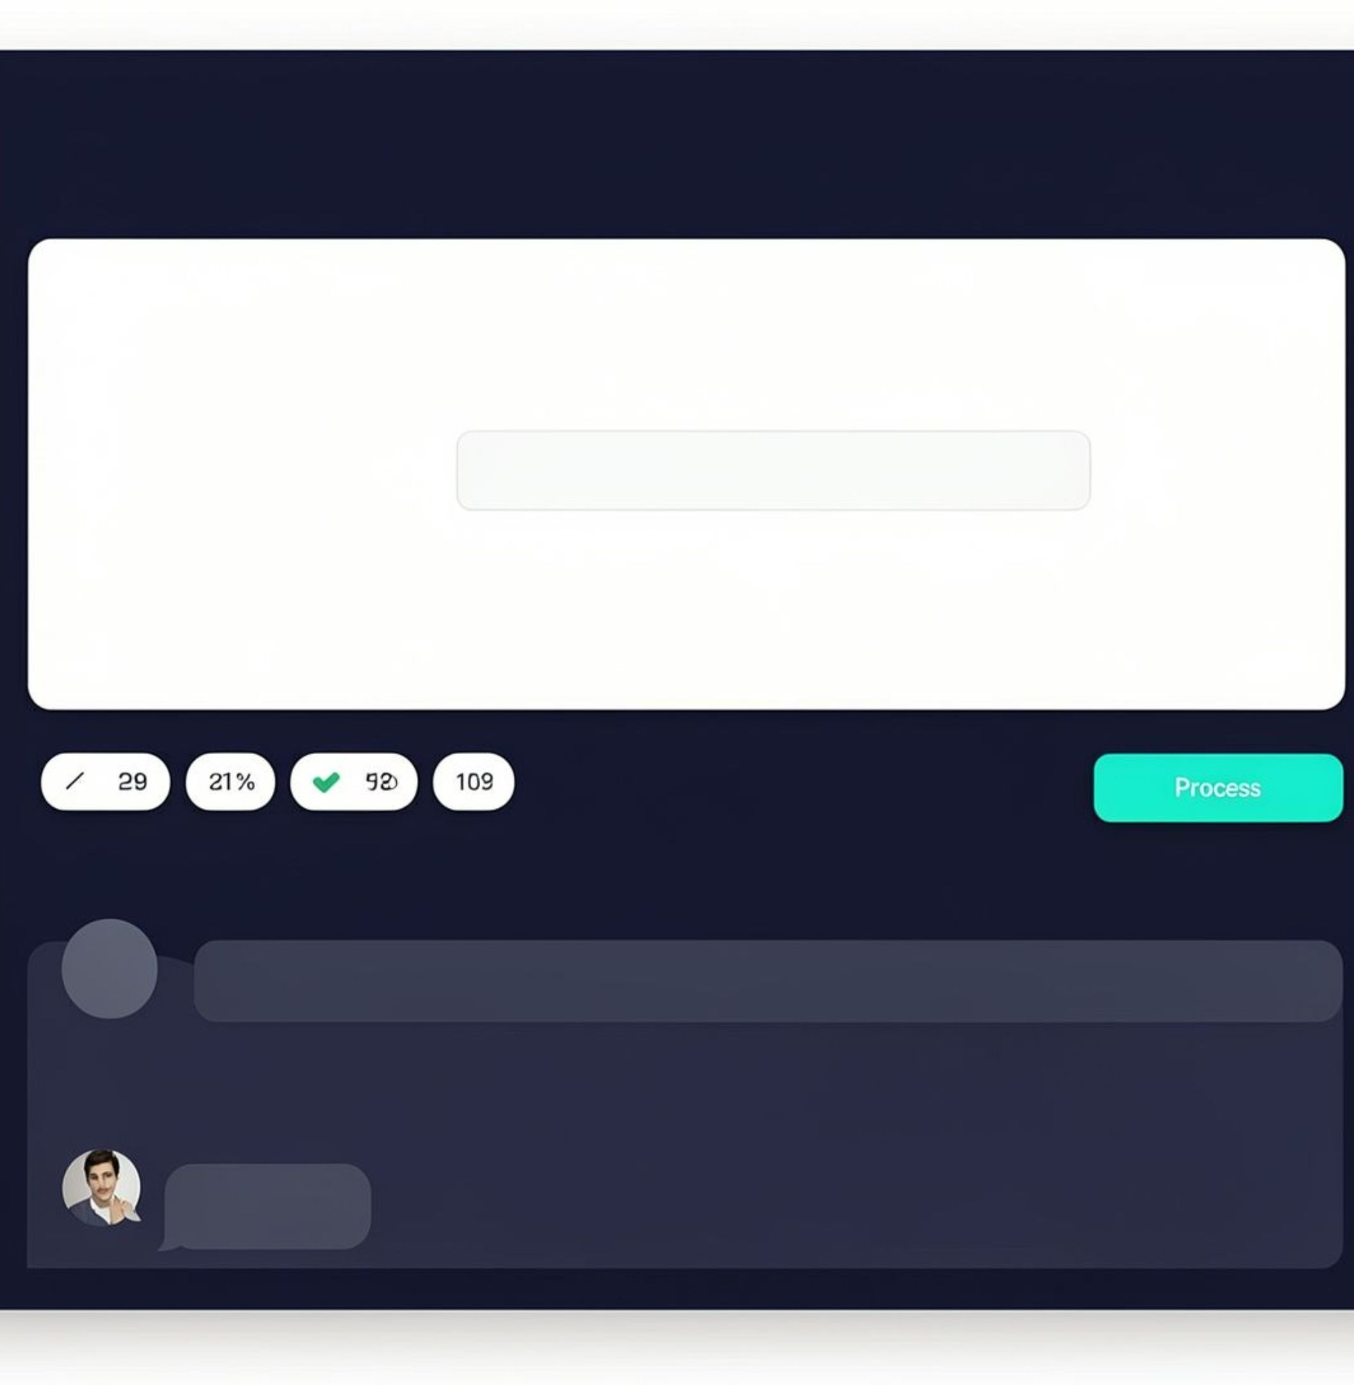



USER EXPERIENCE
A simple interface hides a complex pipeline
Upload once
Process multiple PDFs with one click.
Ask naturally
Use natural language instead of relying on keywords.
See the work
Review semantic retrieval, short chat history, and processing feedback in one Streamlit interface.
08

Slide 9
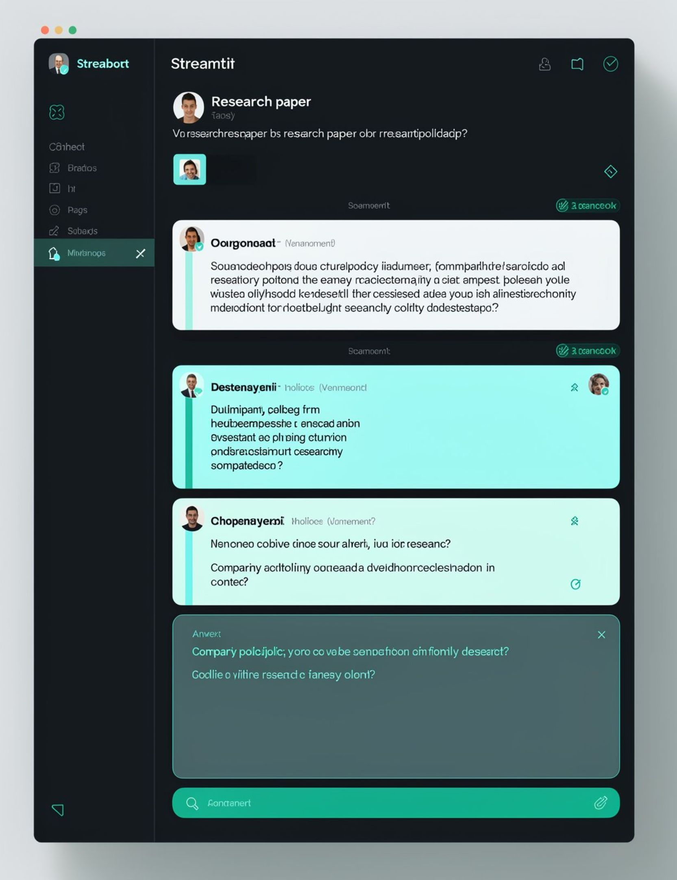
CROSS-DOCUMENT QA
The chatbot answers across documents
MULTI-DOCUMENT QUERY
“Summarize the key points from the research paper and the company policy.”
RESUME QUERY
“What programming languages are mentioned in the resume?”
EXAMPLE RESPONSE
Python, C++, Java, and SQL.
09

Slide 10
PROJECT OUTCOME
THE PROJECT PROVES AN END-TO-END RAG WORKFLOW
NEXT STEPS
Cloud deployment · evaluation metrics · authentication · persistent vector storage · DOCX/PPTX support · source tracking · stronger open-source or hosted LLMs
Document retrieval meets LLM-based answer generation through FAISS and an accessible Streamlit interface.
10

